Slide 1

penetration Testing

Slide 2
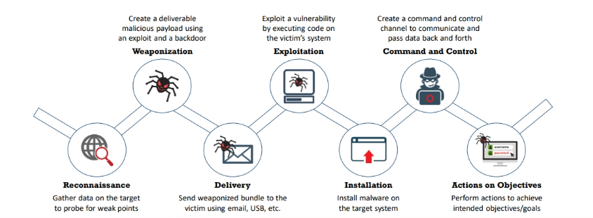
Penetration testing life cycle

Slide 3

Why is penetration testing important?
As well as uncovering weaknesses before attackers can exploit them, pen testing also gives an insight into the security posture of a system.
It ensures that legal and regulatory standards ae being met and that an organisation is adhering to industry best practices and reduces reputational damage.
Incident response is also affected by pen testing as an organisation can practice their response to real-world incidents in a controlled environment.

Slide 4

The importance of different types of penetration testing
Each type of penetration test is designed to uncover different kinds of vulnerabilities and help organisations strengthen their security by providing a comprehensive view of potential risks.
Regular and diverse testing ensures robust defense mechanisms against a wide range of threats.

Slide 5

Network pen testing
Objective: Evaluate the security of a network's infrastructure, including its servers, devices, and communication channels.
Scope: Tests might include external (internet-facing) or internal (within the organization) networks.
Methods: Scanning for open ports, vulnerabilities in services, misconfigurations, and weaknesses in firewall or IDS/IPS settings.
Example: Simulating an attack on a company’s external IP addresses to identify vulnerabilities that could be exploited by attackers.

Slide 6
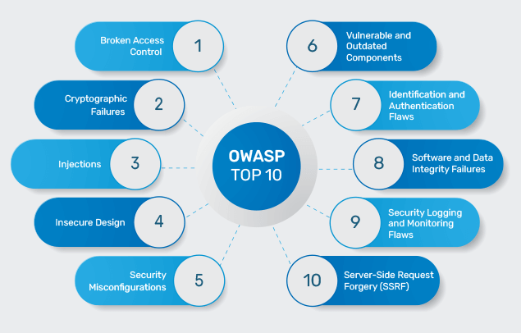
Web application penetration testing
Objective: Identify security issues in web-based applications, such as websites and web services.
Scope: Focuses on the application layer, including front-end and back-end components.
Methods: Testing for common web vulnerabilities such as SQL injection, cross-site scripting (XSS), cross-site request forgery (CSRF), and insecure authentication mechanisms.
Example: Exploiting a poorly coded login page to bypass authentication and gain unauthorized access.

Slide 7

Mobile application penetration testing
Objective: Assess the security of mobile applications on platforms such as iOS and Android.
Scope: Includes client-side and server-side components, along with the associated APIs.
Methods: Testing for insecure data storage, weak encryption, improper session management, and flaws in the mobile app's communication with backend services.
Example: Analyzing a mobile banking app for vulnerabilities that could allow an attacker to steal sensitive user information

Slide 8

Wireless penetration testing
Objective: Examine the security of wireless networks and associated devices.
Scope: Includes wireless protocols (e.g., Wi-Fi), encryption standards, and devices connected to the wireless network.
Methods: Testing for weak encryption (e.g., WEP/WPA), rogue access points, unauthorized devices, and man-in-the-middle attacks.
Example: Attempting to crack the WPA2 password of a company’s Wi-Fi network to gain access to internal systems

Slide 9

Cloud penetration testing
Objective: Assess the security of cloud-based services and infrastructure.
Scope: Involves testing cloud environments like AWS, Azure, or Google Cloud, including virtual machines, storage, and cloud-specific services.
Methods: Testing for misconfigurations, insecure APIs, improper access controls, and vulnerabilities in cloud service deployments.
Example: Checking if a misconfigured S3 bucket on AWS allows unauthorized access to sensitive files.

Slide 10

Iot penetration testing
Objective: Assess the security of IoT devices and their associated networks.
Scope: Includes connected devices, sensors, and communication protocols.
Methods: Testing for weak default passwords, insecure communication channels, and vulnerabilities in the firmware.
Example: Hacking into a smart home device like a thermostat to take control of the system remotely.

Slide 11

Thank you
someone@example.com

